Slide 1
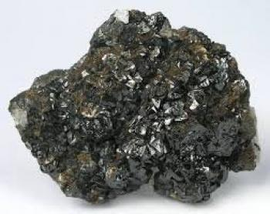
PEROVSKI-WHAT??
Notes:
James Starts
(Not sure what the title should be yet, open to suggestions)
How about this for a title?
I love it! Haha!

Slide 2


Slide 3
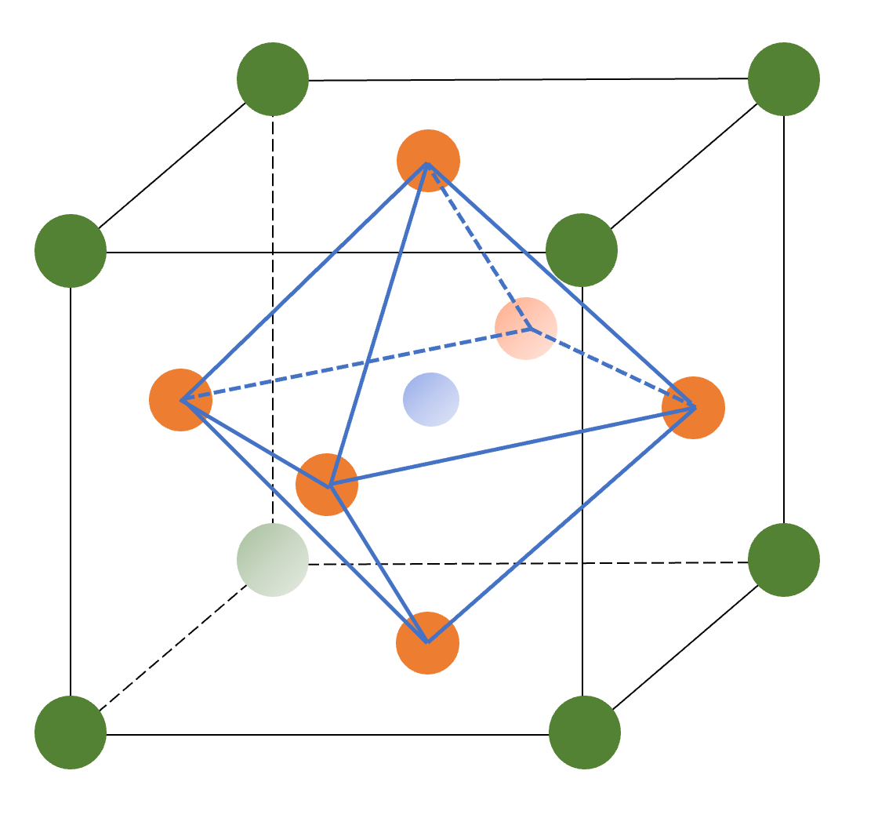
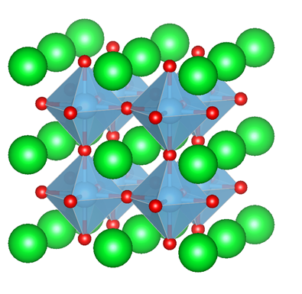
What is a perovskite?
A group of related minerals and ceramics having the same crystal structure as this...
https://www.youtube.com/watch?time_continue=3&v=fVqsCRvPAY4
Notes:
Ideas to talk about:
Arrangement of atoms and crystal structure
What do the different structures indicate/mean
The big picture, what are perovskites used for, why are they important
Should we describe a ceramics?

Slide 4
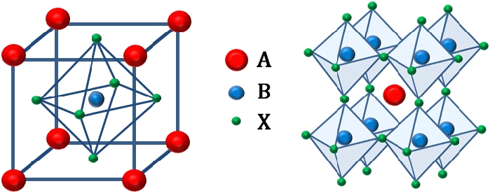
History of Perovskites
A perovskite is any material with the same type of crystal structure as calcium titanium oxide (CaTiO₃), known as the perovskite structure, or ABX₃ with the oxygen in the edge centers. Perovskites take their name from the mineral, which was first discovered in the Ural mountains of Russia by Gustav Rose in 1839 and is named after Russian mineralogist L. A. Perovski (1792–1856).

Slide 5
Structure of the perovskite
The general chemical formula for perovskite compounds is ABX₃, where 'A' and 'B' are two cations of very different sizes, and X is an anion that bonds to both. The 'A' atoms are larger than the 'B' atoms. The ideal cubic structure has the B cation in 6-fold coordination, surrounded by an octahedron of anions, and the A cation in 12-fold cuboctohedral coordination.

Slide 6
Perovskite Structure
In the idealized cubic unit cell of such a compound, type 'A' atom sits at cube corner positions (0, 0, 0), type 'B' atom sits at body-center position (1/2, 1/2, 1/2) and oxygen atoms sit at face centered positions (1/2, 1/2, 0). (The diagram shows edges for an equivalent unit cell with A in the body center position, B at the corners, and O at mid-edge positions).

Slide 7
Perovskite Structure Video
More in depth video on perovskite structure!
https://www.youtube.com/watch?v=sc0uWcOZSNU

Slide 8
My Summer Project
Problem: Can a perovskite be used as an ink, to print a capacitor?
Hypothesis: If silver, tantalum, and niobium oxides are combined to for ANT, then the powder could be used in an ink to print a capacitor using an ink jet printer.
Experiment:
ANT will be created by calcining the proper batch in a furnace.
The ANT will then be used in solution to form an ink, that will print in a Dimatix inkjet printer.
Data:
Analysis:
Conclsuion:

Slide 9
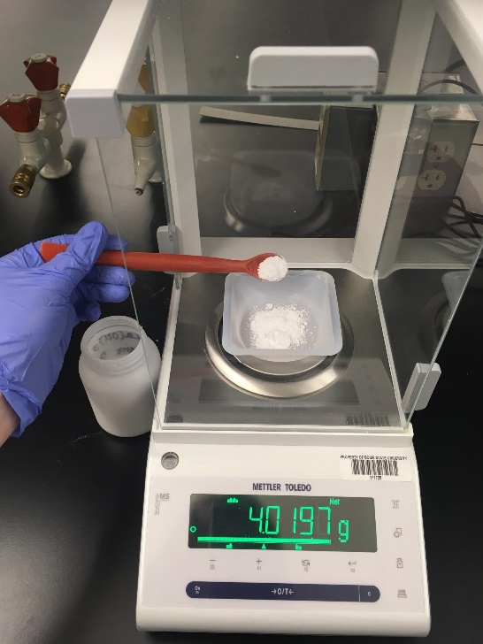
Laboratory Procedure
Measuring all the proper amounts of chemical powders for the “batch”

Slide 10
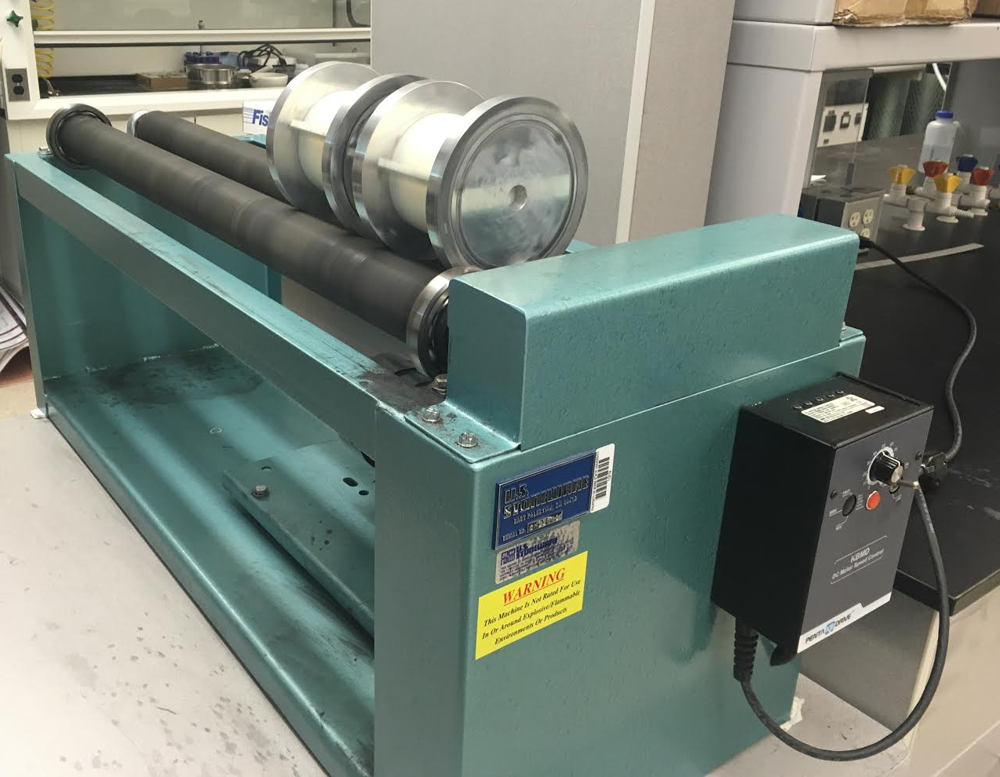
Laboratory Procedure
The powders must be “milled”, or mixed thoroughly, together in a solution of pure water before they can be calcined.

Slide 11
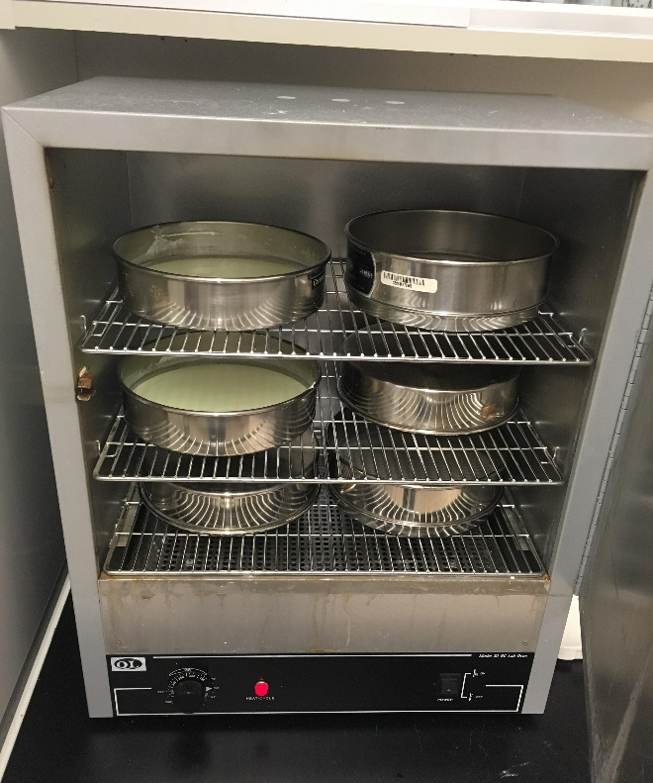
Laboratory Procedure
Next step is to dry the solution so that only a powder is left

Slide 12
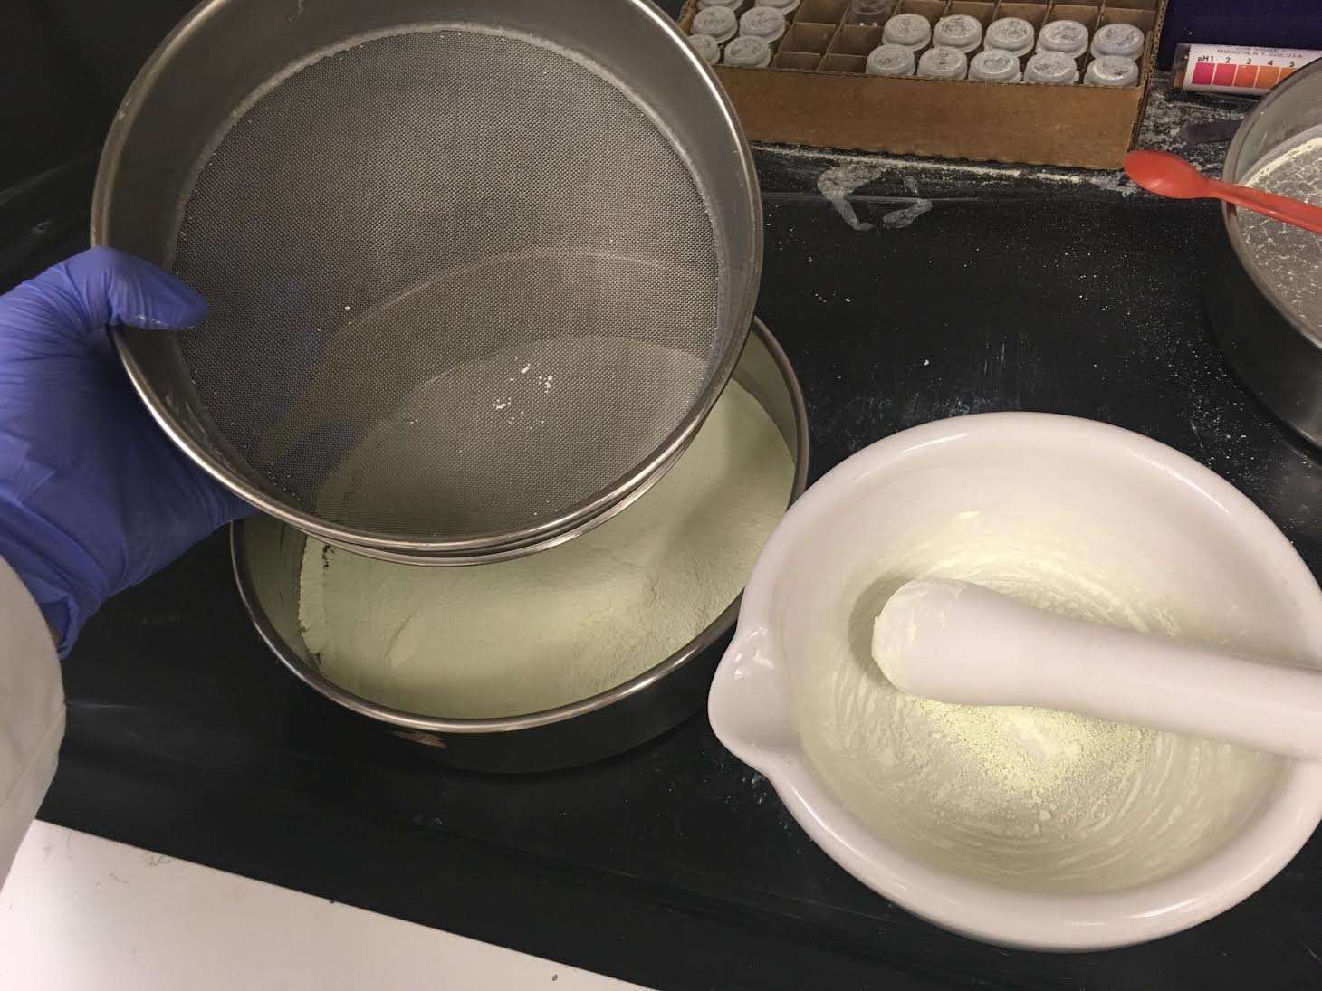
Laboratory Procedure
Once completely dried, it’s crushed into a fine powder, as fine as sifted flour

Slide 13
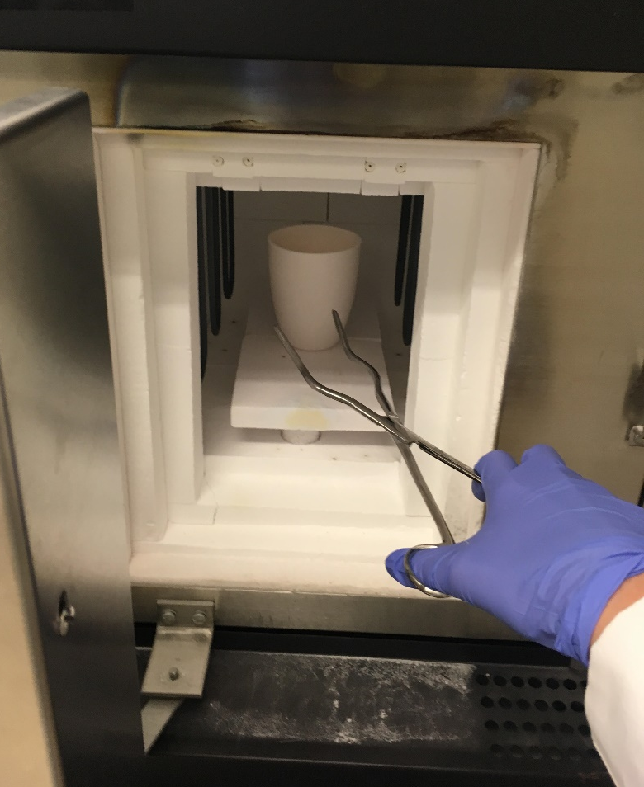
Laboratory Procedure
The box furnace is where the magic happens! This is where the powder is heated to extremely high temperatures and chemically combine to form the new substance

Slide 14
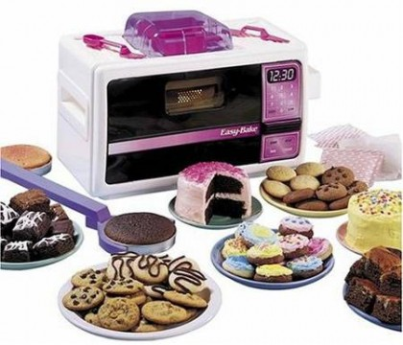
Calcining - Basically cooking up stuff in the lab!
Notes:
James Talks
Claire
Explain the different sites within a perovskite, point them out in the image
Explain the B-site shrinkage
Talk about how you are creating a model to classify why this stuff is happening
James
Explain the ceramic ink of Silver oxide etc.
Should we explain what ceramic is?
Air Force interest?
Calcining and what it is?
We can switch the pictures around however you like… no preference

Slide 15
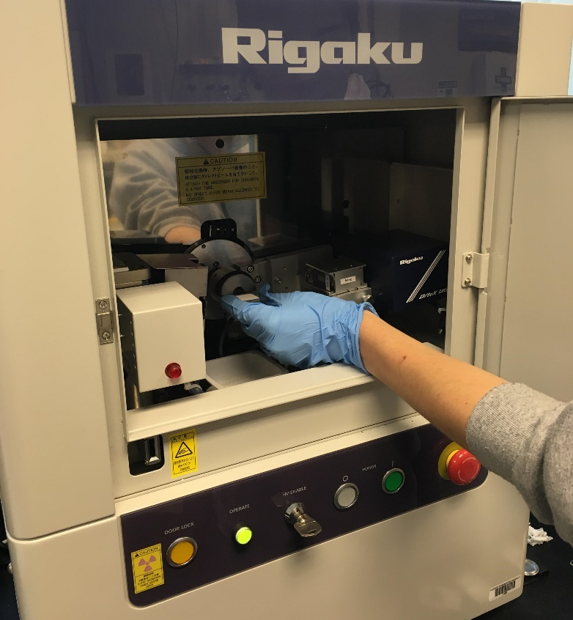
Laboratory Procedure
After the furnace and another grinding into a fine flour like powder, the X-ray Diffraction machine will analyze the substance and what is we created in the furnace

Slide 16
XRD Results

Slide 17
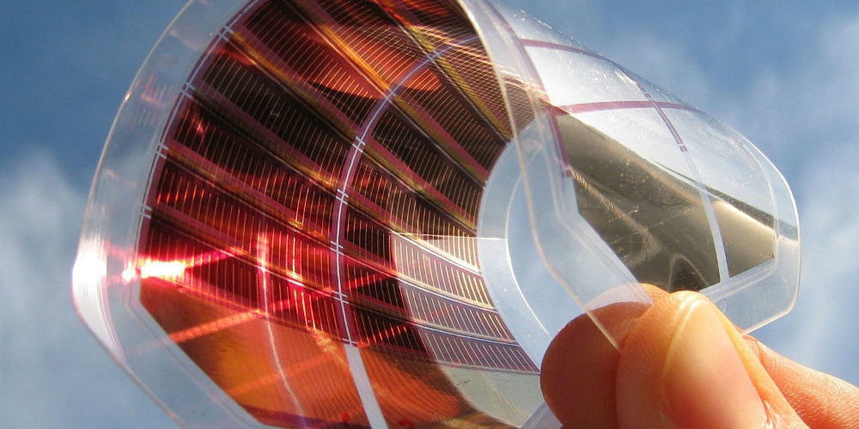
How are perovskites going to be used?
Solar Power and Electric Circuits
TED ED https://www.youtube.com/watch?v=2ccar3uqWsw
Notes:
James talk about the solar applications

Slide 18
More videos…
Perovskites for undergrads https://www.youtube.com/watch?v=d2npedzLFaA
Constructing Solar Cell https://www.youtube.com/watch?v=ZdpQgPJ1Plk

Slide 19

Time for an activity!
Notes:
Explain what the activity is, and explain that we will only be making the octahedron shape of the perovskite, without the unit cell. We will be leaving the A-site out of our structures for the sake of time and ease.
Grab some volunteers to help hand out supplies to all the kids, and anyone else that would like to participate.

Slide 20
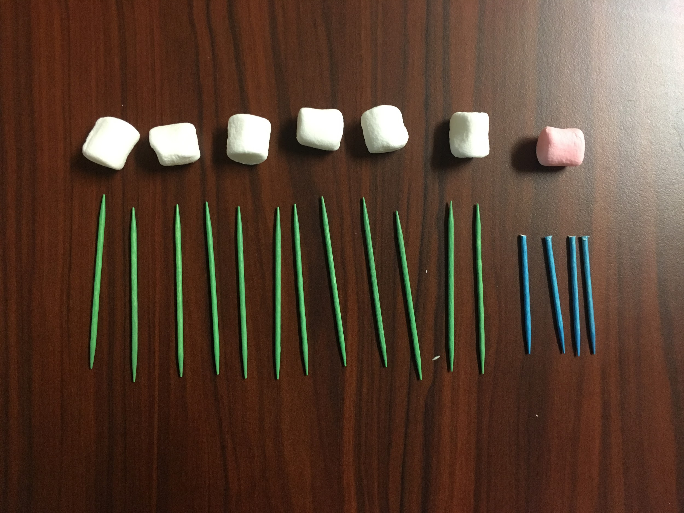
Notes:
Make sure that everyone has all their materials, if not raise hand and we will give them what they need.

Slide 21
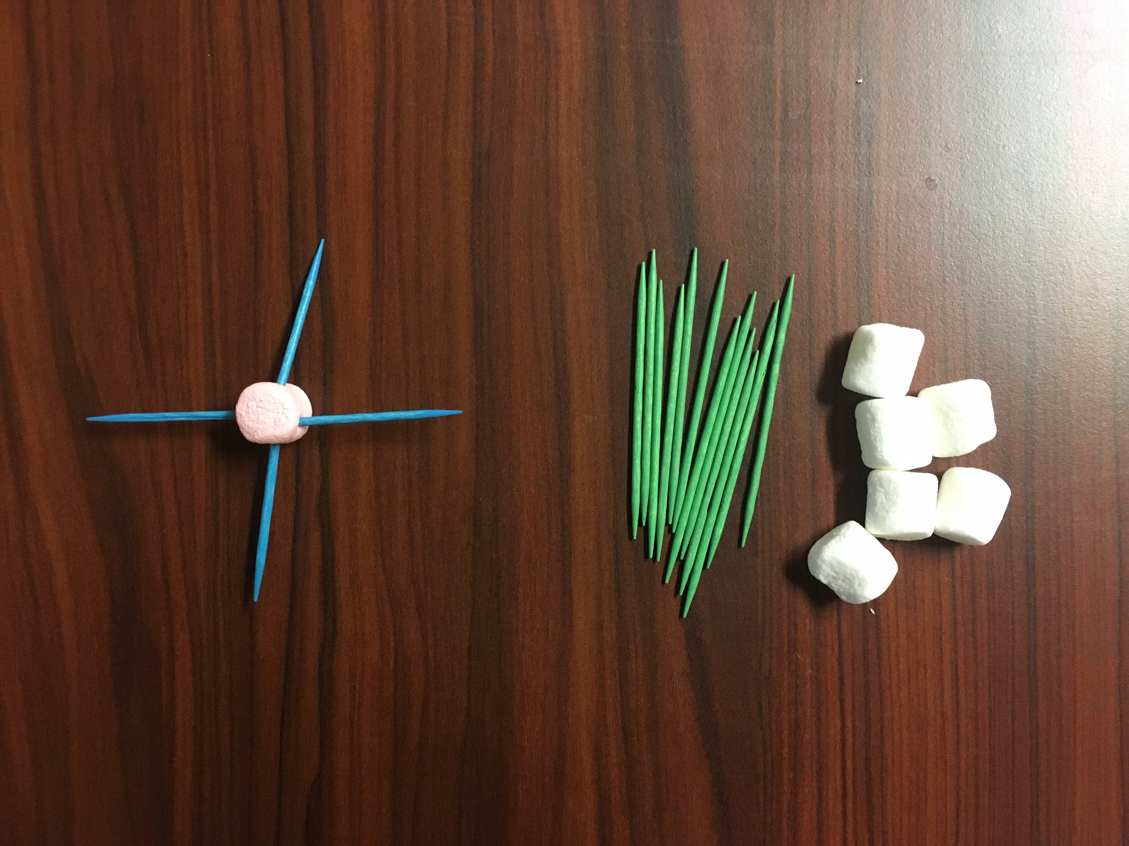
Notes:
Walk the kids through it step by step.

Slide 22
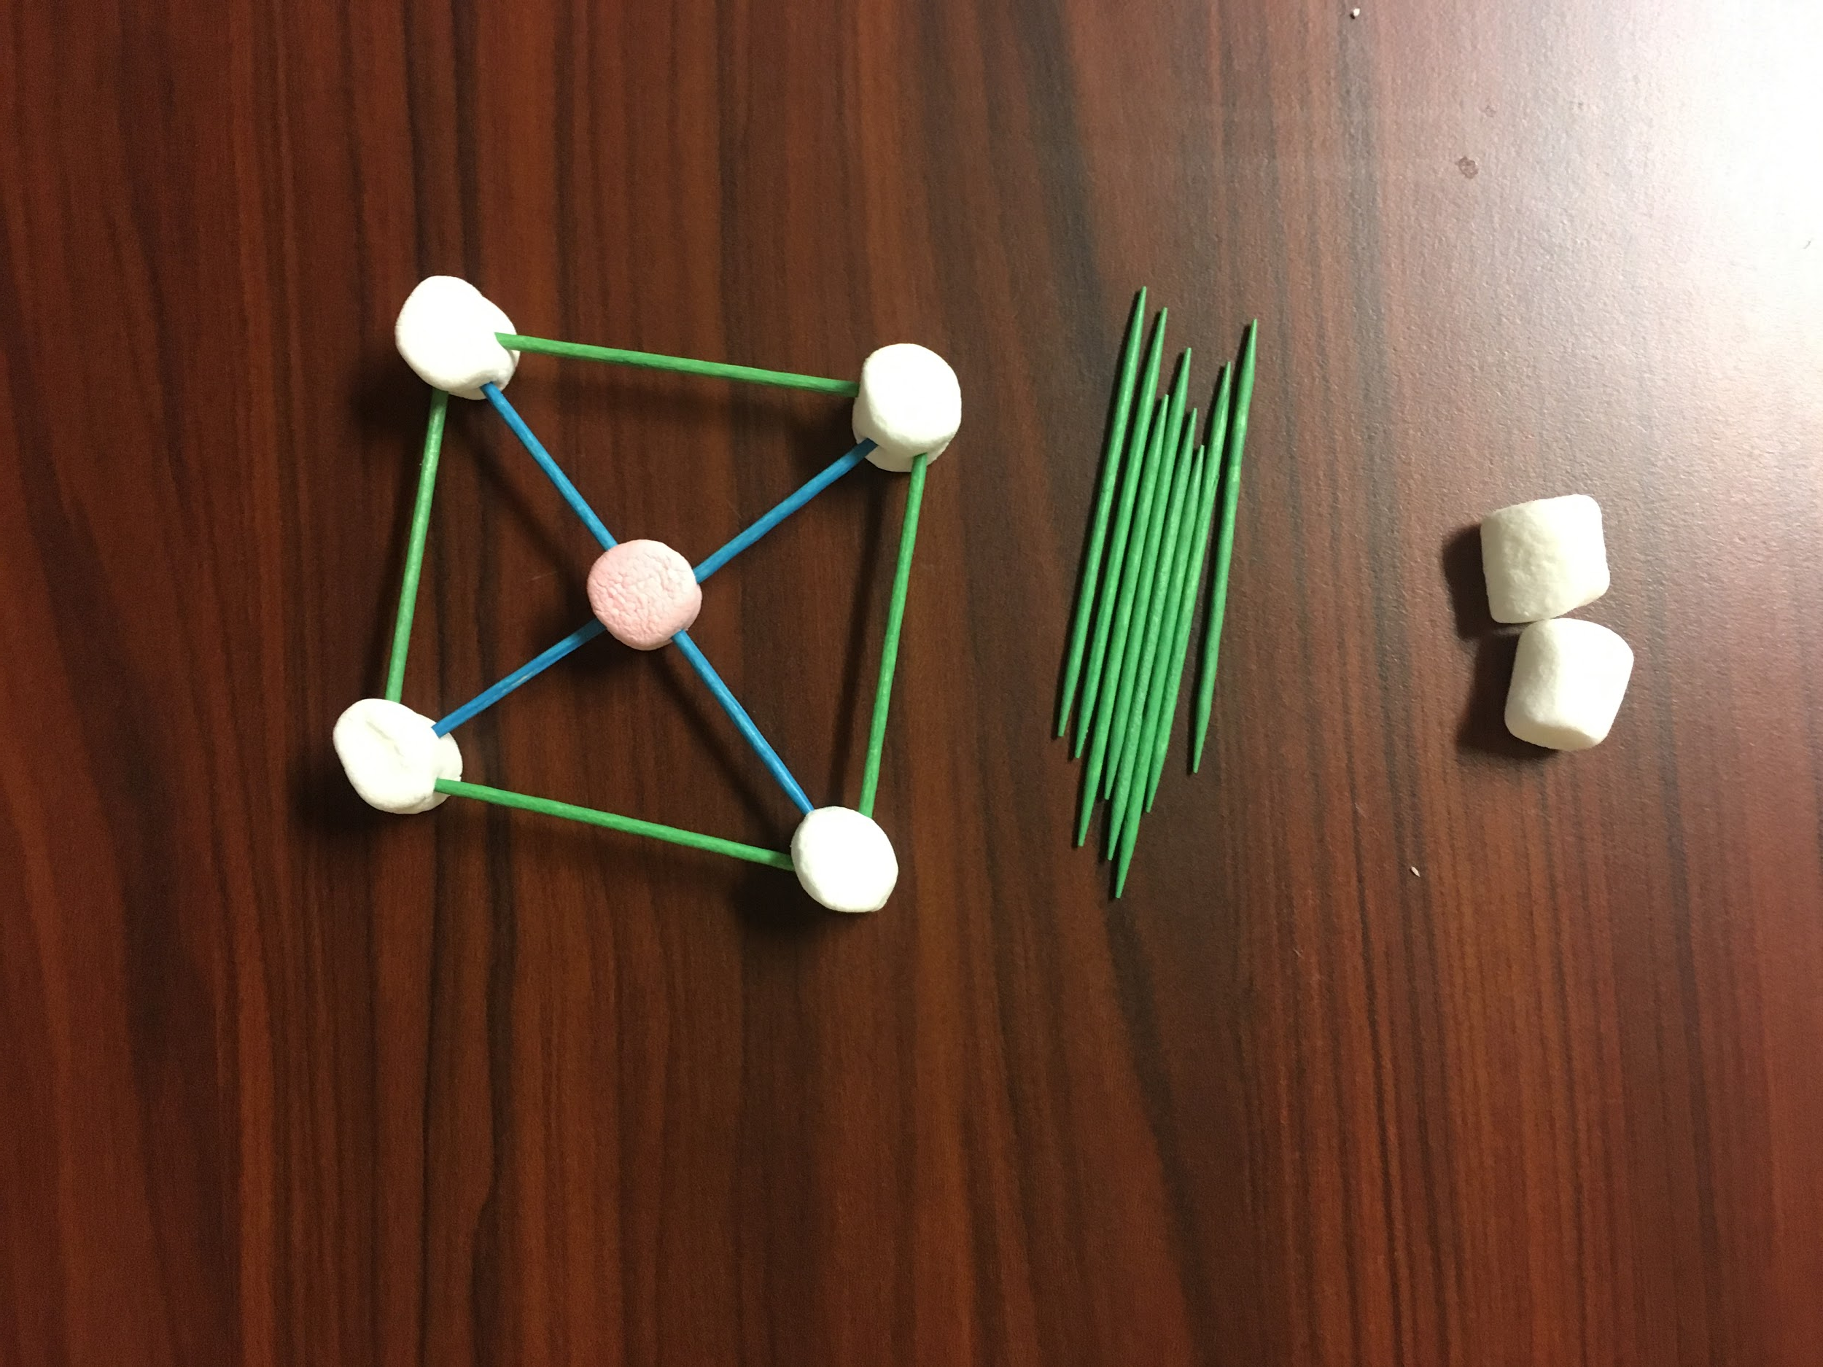

Slide 23
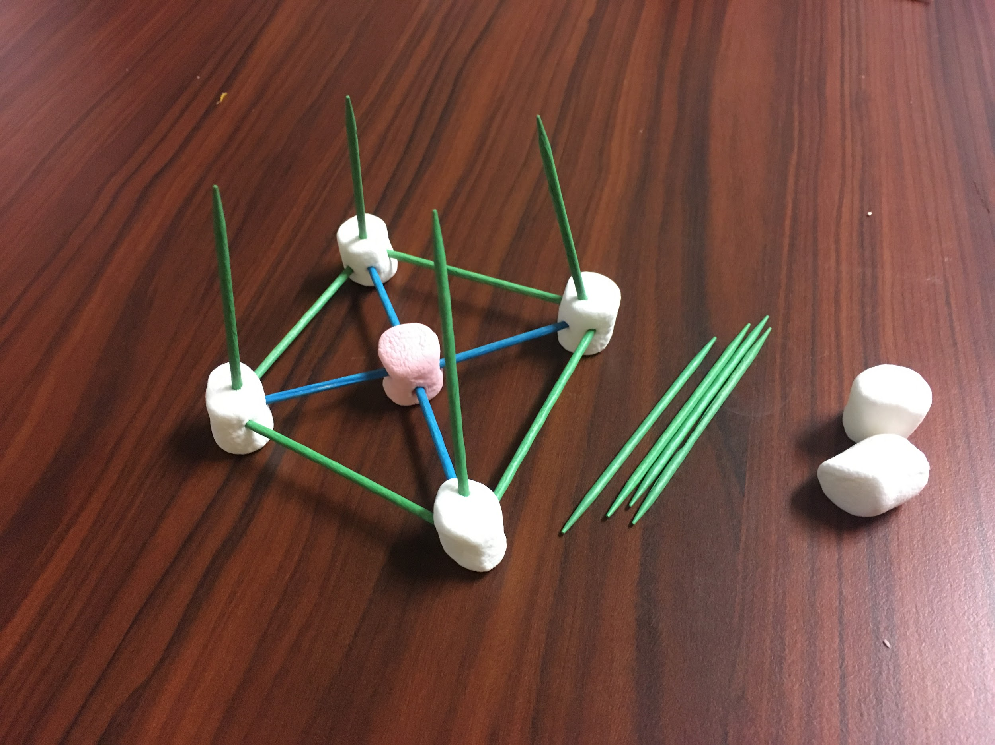

Slide 24
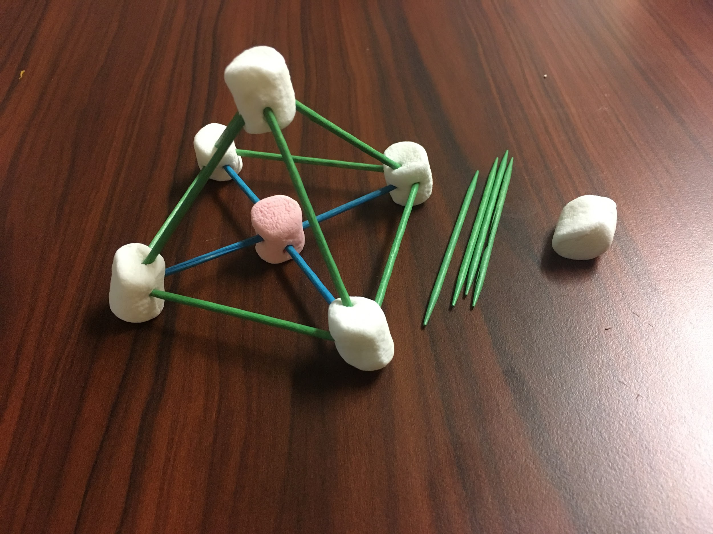

Slide 25
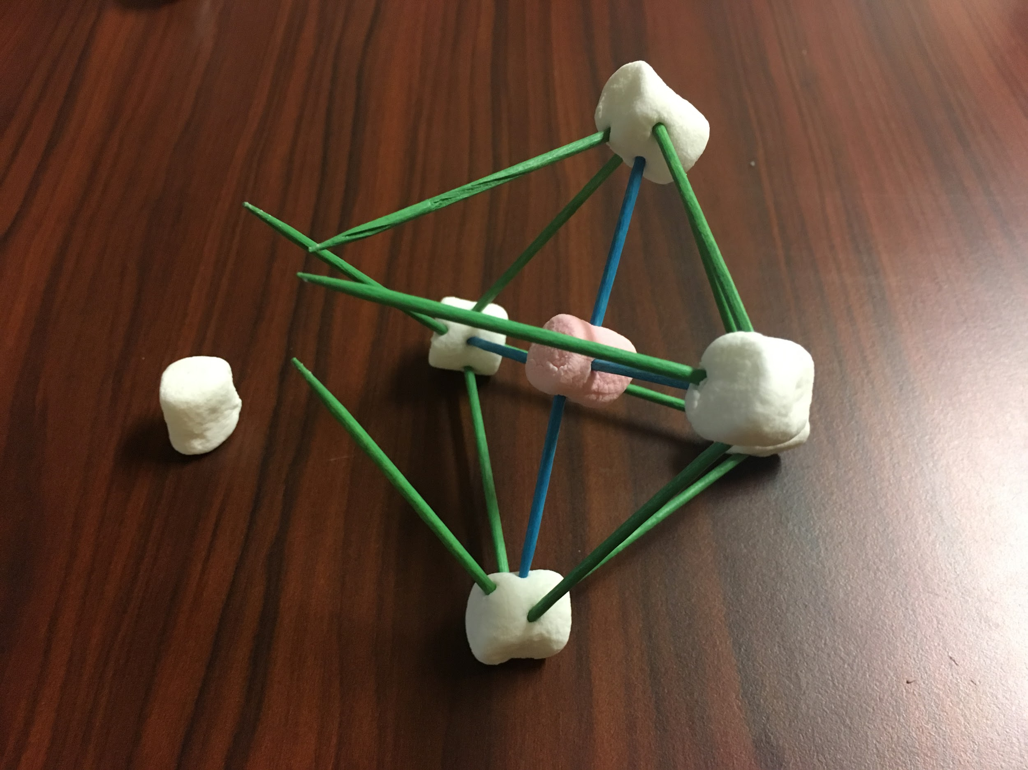

Slide 26
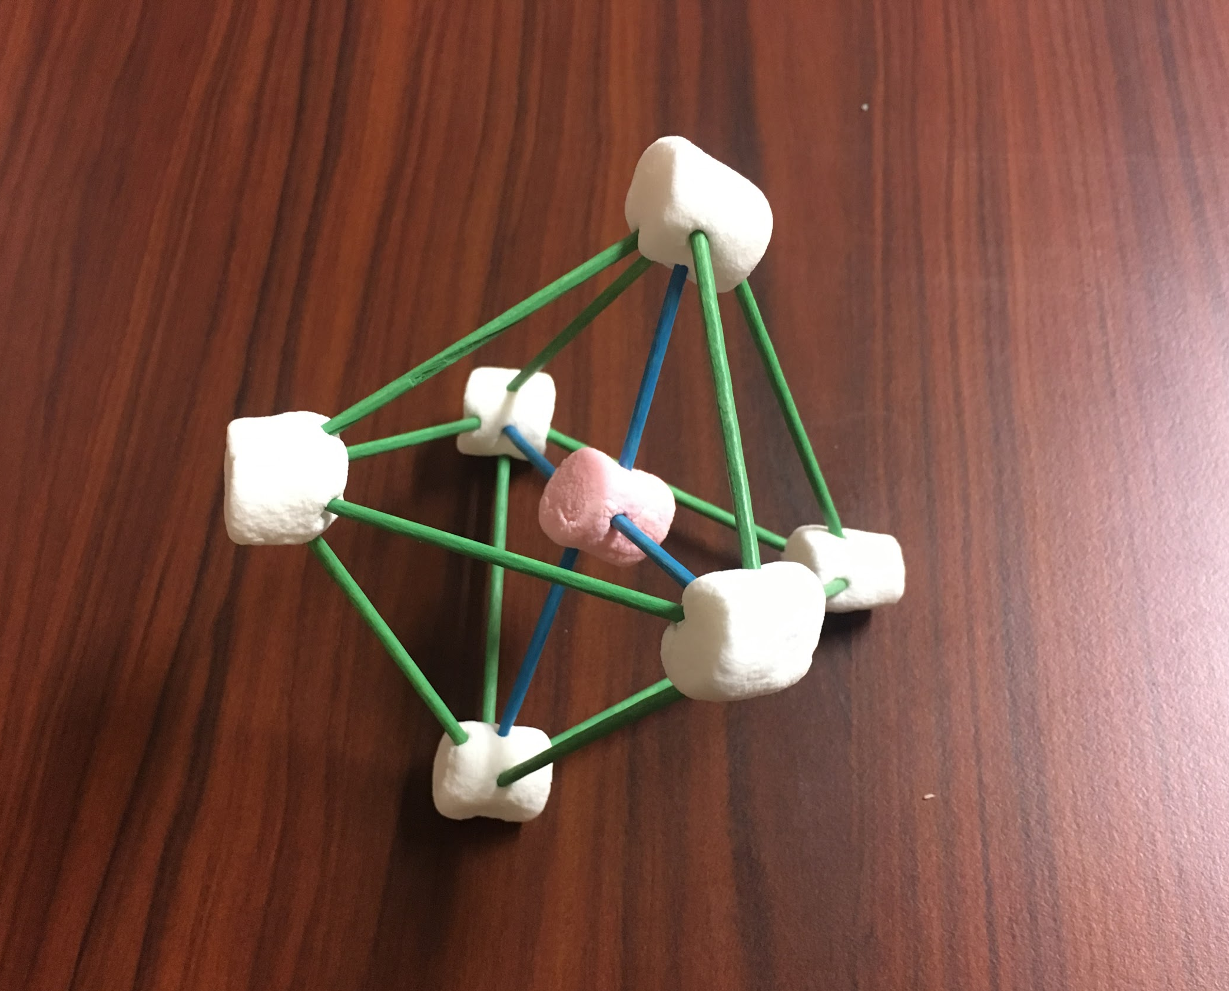
Notes:
Describe the significance of the marshmallow in the middle, and relate it to the “box” it would usually “sit” inside. Stress that the blue toothpicks aren’t actually there, just holding the marshmallow in place… or maybe we should use a big marshmallow in the center without toothpicks?

Slide 27
Notes:
Specific properties given by the perovskites - James look up solar?
How the crystal structure is arranged gives it different characteristics, such as electrical conductivity ETC.
Other Crystal structure

Slide 28

Thank you!

Slide 29
Works Cited
Face Centered Cubic Structure. 26 September, 2015. http://www.conceptualphysicstoday.com/2015/09/face-centered-cubic-structure.html.
Body Centered Cubic Structure. https://www.e-education.psu.edu/matse81/node/2132.
Nicola Ergo. Crystallographic Planes and Directions. 6 June, 2016. https://www.slideshare.net/NicolaErgo/crystallographic-planes-and-directions-62776876.
Ccp Anion Packing Examples. https://www.seas.upenn.edu/~chem101/sschem/ionicsolids.html.
Solid State. CaTiO3 Perovskite Structure. 12 August, 2012. https://commons.wikimedia.org/wiki/File:CaTiO3_perovskite_structure.png.
Ubuntucuber. Rubik’s Cube Pranks. 27 March, 2010. www.instructables.com/id/Rubiks-cube-pranks/.
BuffaloNickel. Solving the Rubik Cube. 28 September, 2007. http://www.instructables.com/id/How-to-Solve-a-Rubik-s-Cube-1/.

