Slide 1
Intro to materials
Alison Fielding

Slide 2
"To be A teacher is to be A prophet, because you are not preparing kids for the world you grew up in nor are you preparing kids for the world today. You are preparing kids for A world you cannot imagine."
    Gordon brown, MIT dean of engineering.

Slide 3
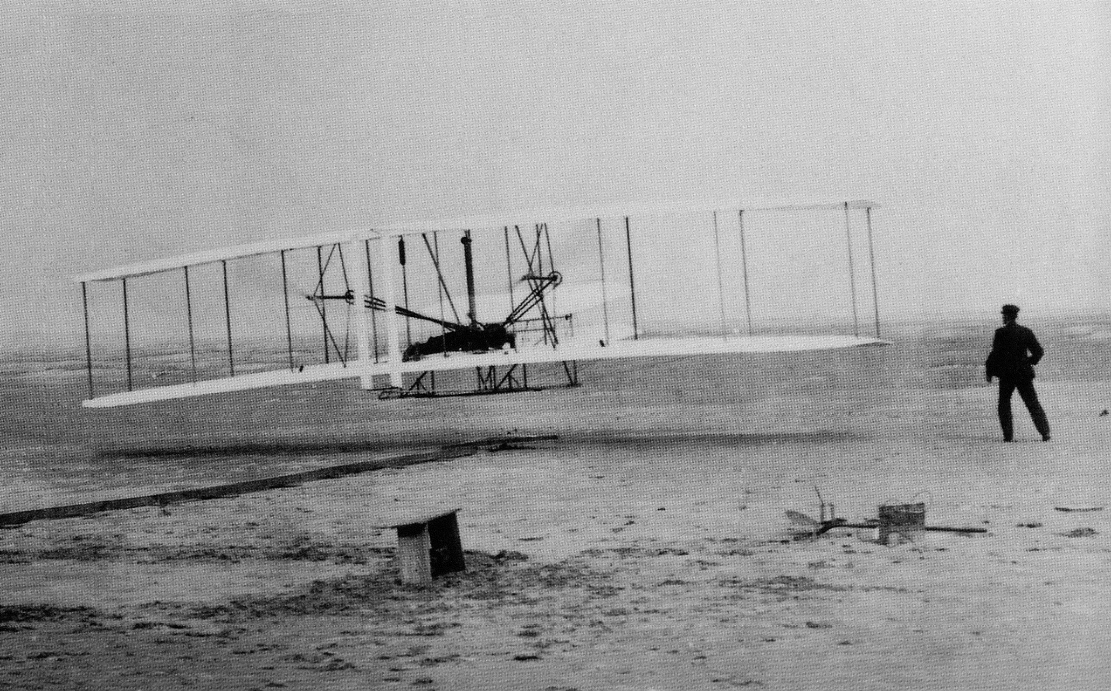
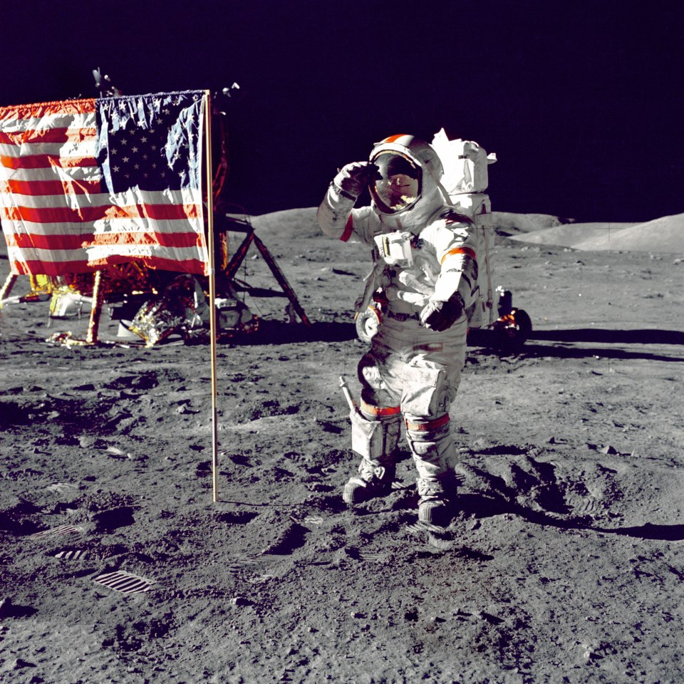
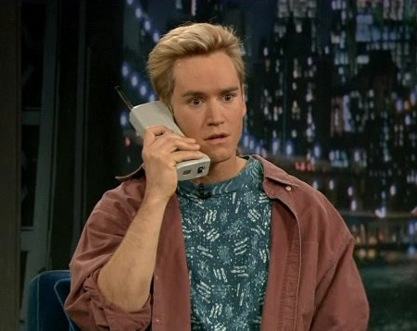
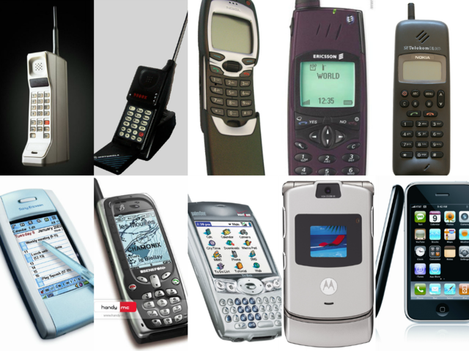
Materials Changing
Notes:
1903 – Wright brothers in Kitty Hawk NC take flight
1969 – Neil Armstrong walks on the moon
1984 – 1994 the Brick phone – Moterola DynaTAC
1992 – first smartphone
2007 – mini computer smartphones – iPhone

Slide 4
Chemistry

Slide 5
Materials Science

Slide 6
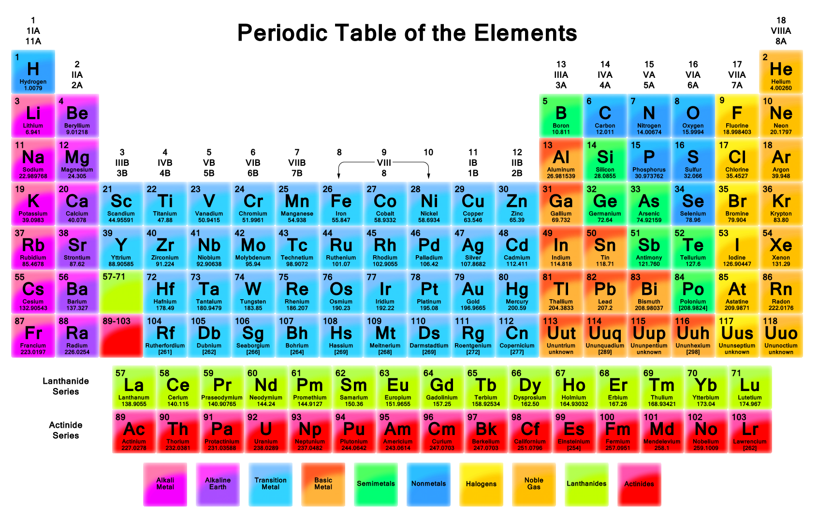
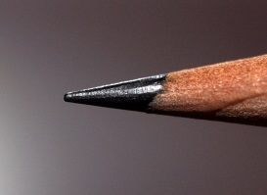
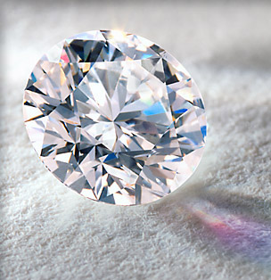
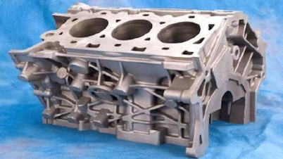
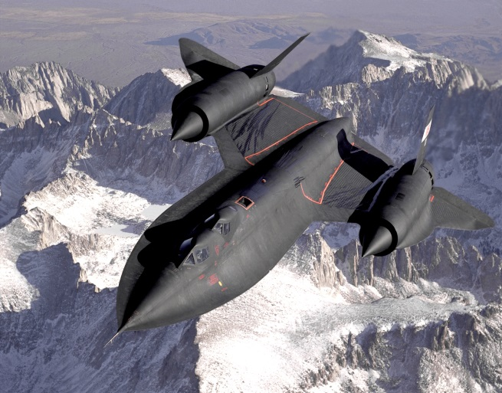
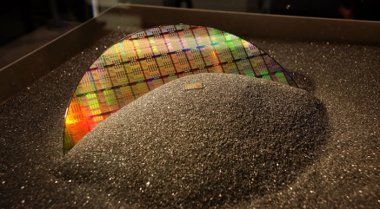
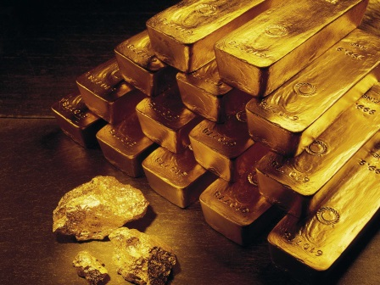
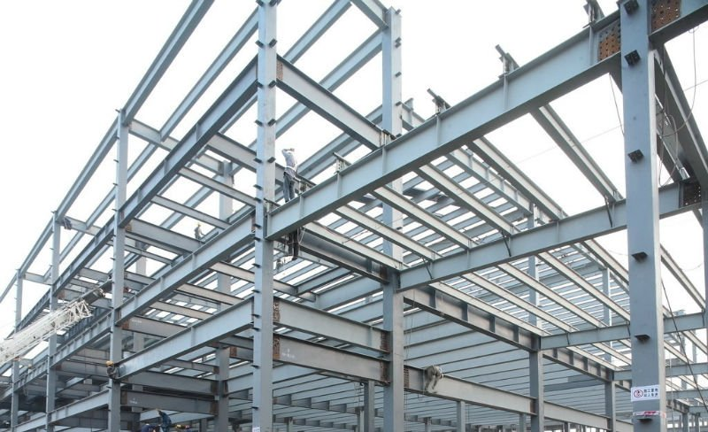
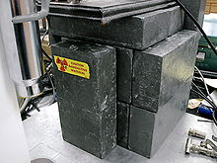
Non-Metals
Alkali/Alkaline Metals
Semi-Metals
Transition Metals
Basic Metals

Slide 7
Material Science is about…
Composition
Structure
Performance
Processing
Understanding and developing a greater appreciation for the importance of the variety of materials in our lives
Studying how materials can be changed or manipulated
The search for new materials
Notes:
7

Slide 8
Definition of Materials Science
Understanding and using the materials in our daily lives
Study of the materials in our lives and how they can be changed or manipulated
Describes the understanding of the solids that emerges from the combined viewpoints of chemistry, physics, and engineering
Involves the generation and application of knowledge relating the composition, structure and processing of materials to their properties and uses

Slide 9
Materials I.D. Lab
Free write – everything you know about the following categories:
    Metal
    Ceramic/Glass
    Polymer
    Composite
Pick one item from the box
    Classify it into one of the categories
    Give your reasoning
    Give your % confidence level

Slide 10
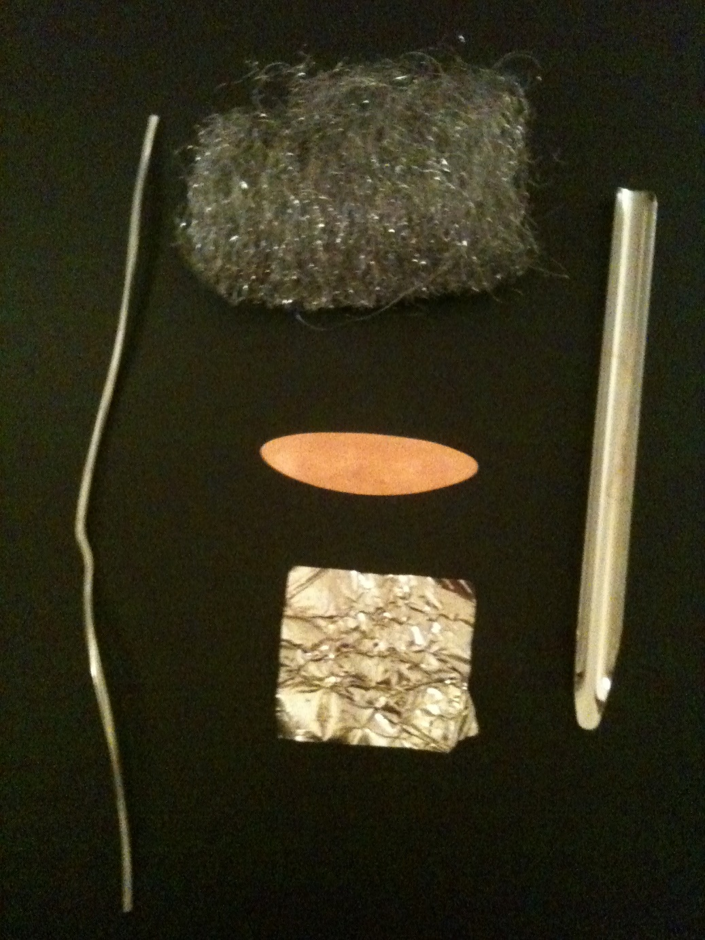
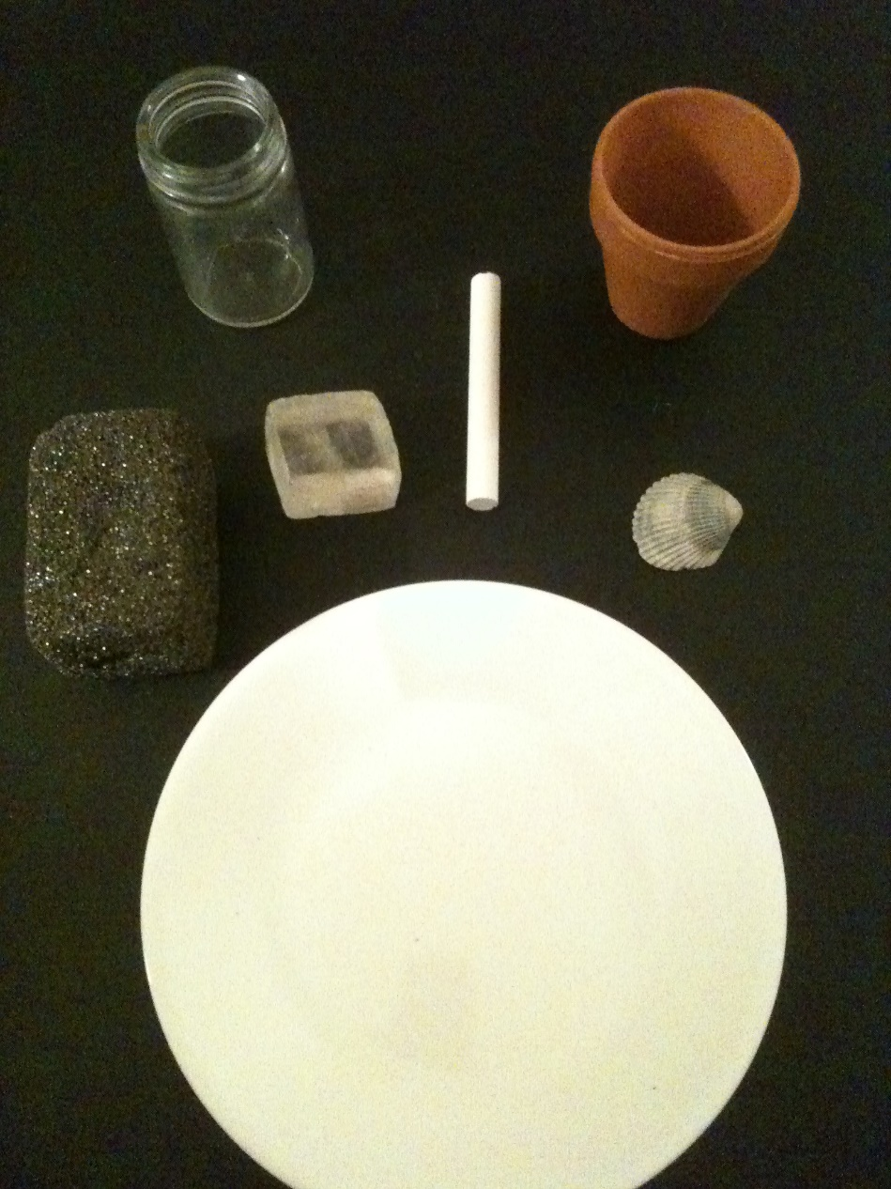
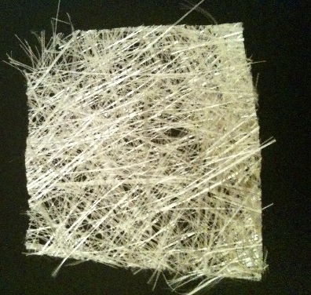
Ceramics
Metals

Slide 11
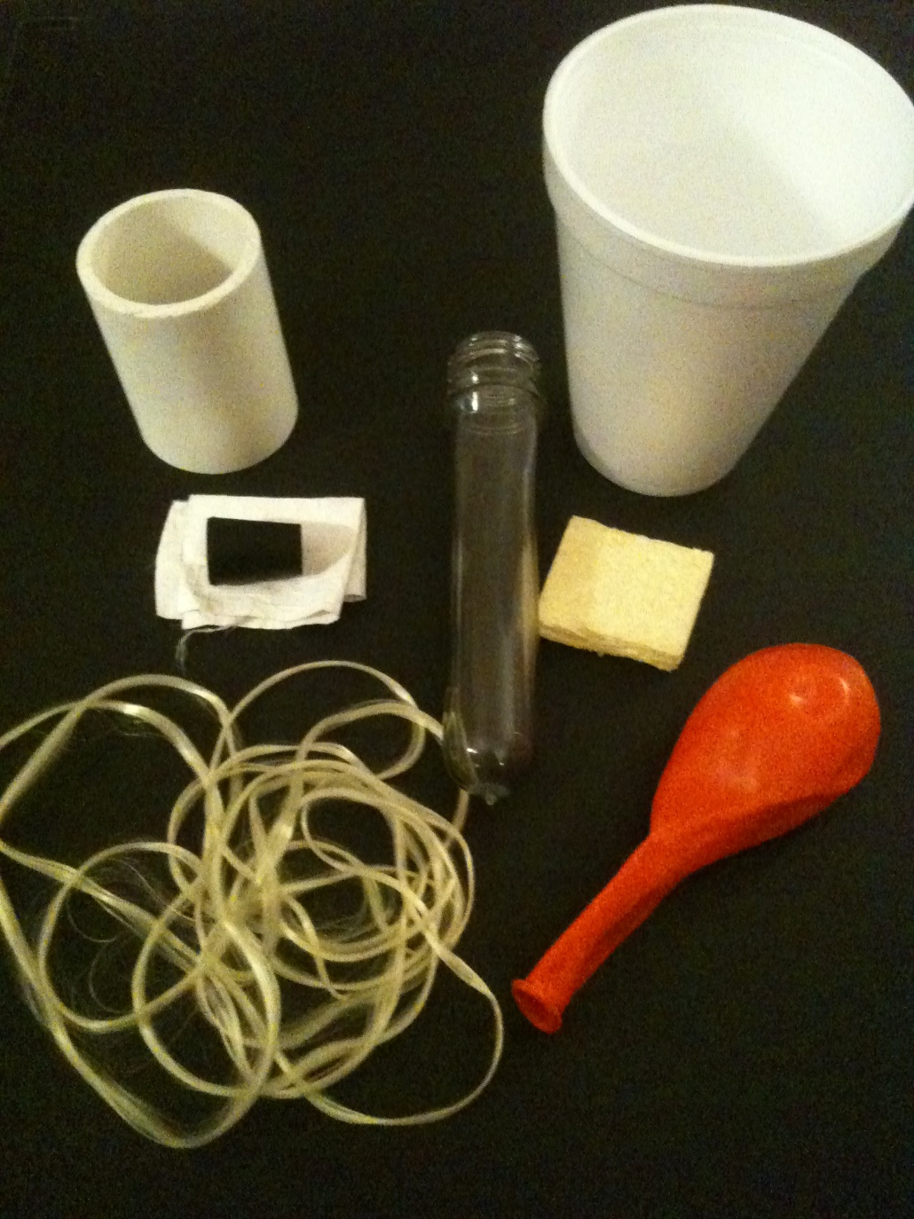
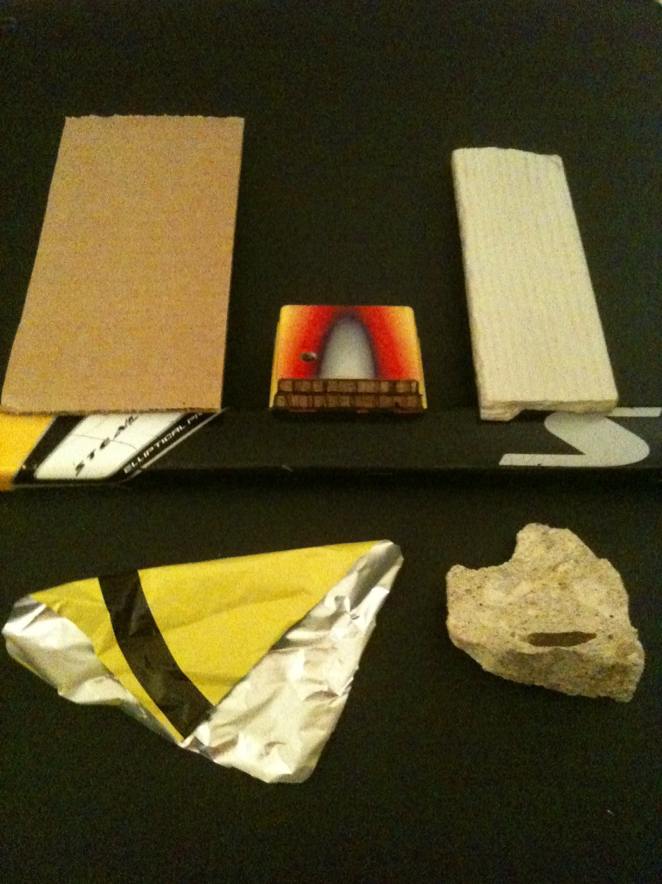
Polymers
Composites

Slide 12
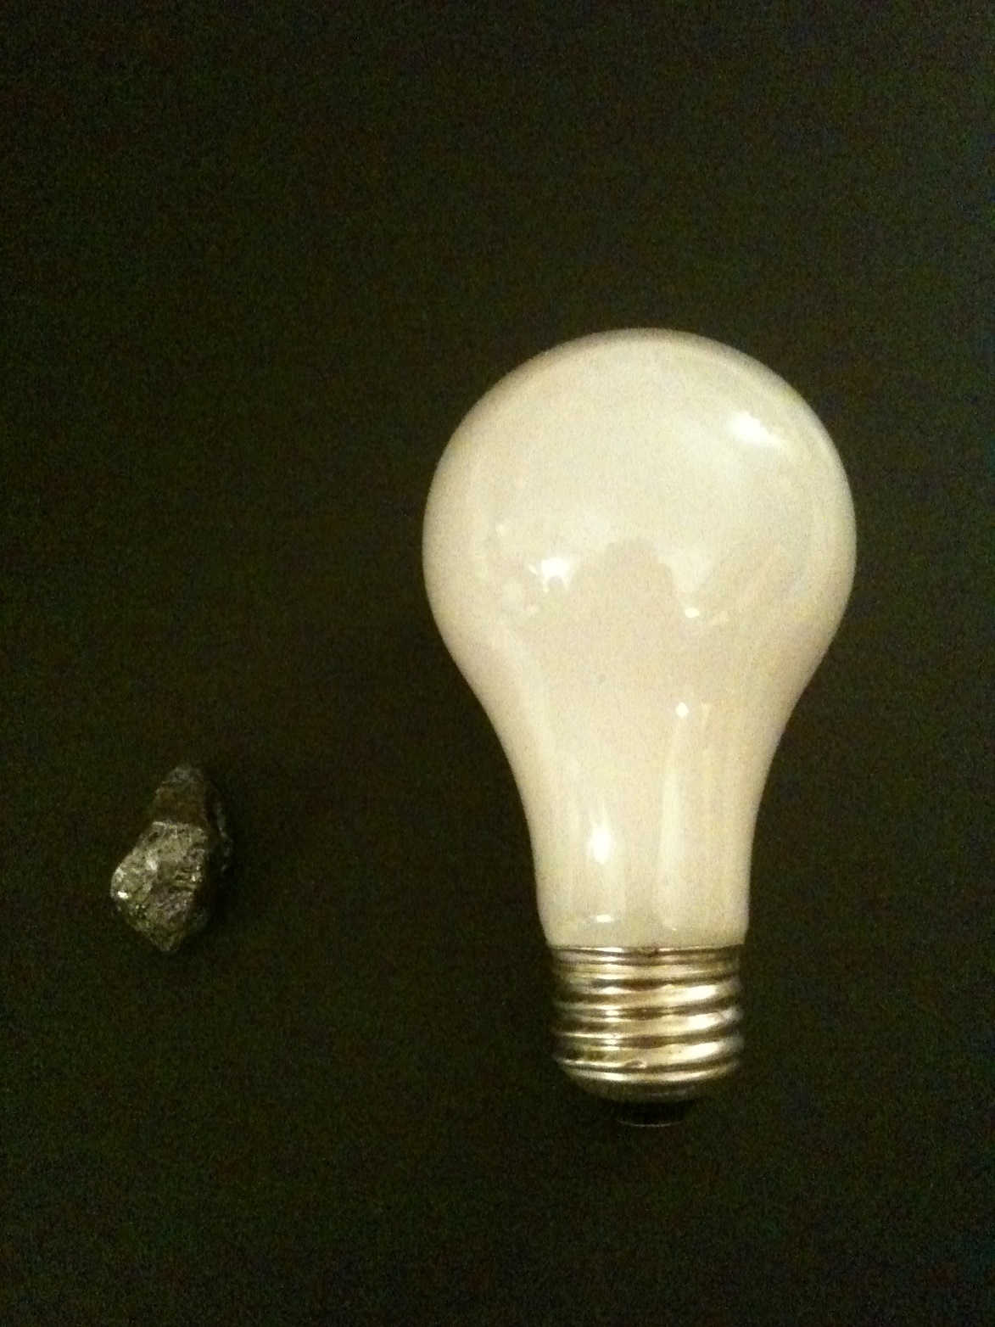
Other
Light bulb is
an assembly
Silicon =
semiconductor

Slide 13
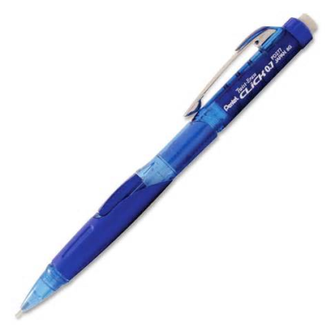
Materials ID Lab
PART II
If you were to take apart a pen, predict how many different pieces you would find. What kind of materials do you think would be used?
Now take the pen apart and determine what materials were used in the making of this item.
DO NOT DESTROY WHEN TAKING APART!!!

Slide 14
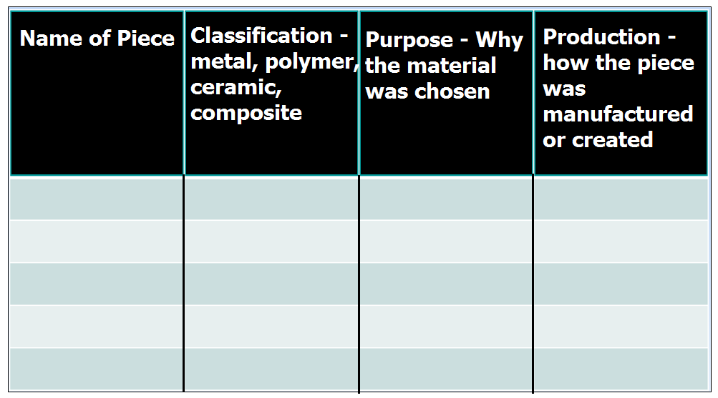
Categorize the materials you found.
Why was each material chosen?
How was each piece manufactured?

Slide 15
Connection to the Materials ID Activity
History Free-Write
  Which category has been used by mankind the longest?
  Why that particular one?
  What did they use it for?

Slide 16
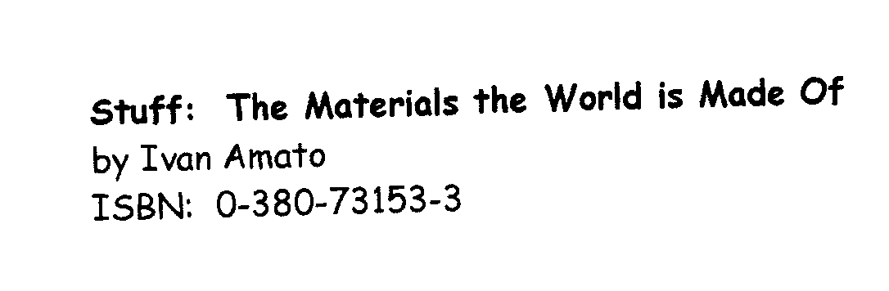
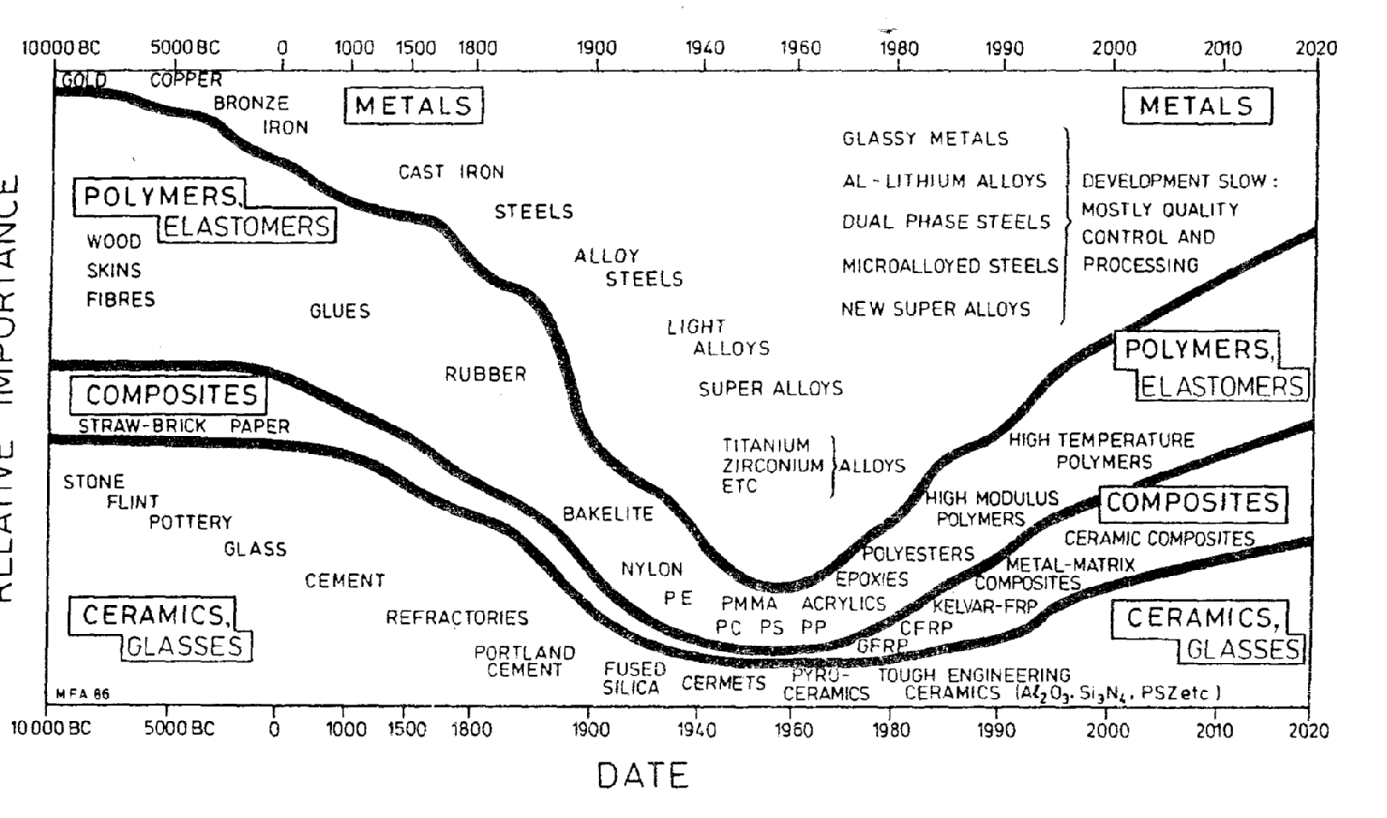
Notes:
Discussion can begin introducing Materials into History…..What a Novel idea…an integrated curriculum

Slide 17
History and Materials
Stone Age
Bronze Age
Iron Age
What age are we in now?

Slide 18
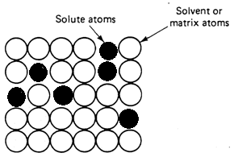
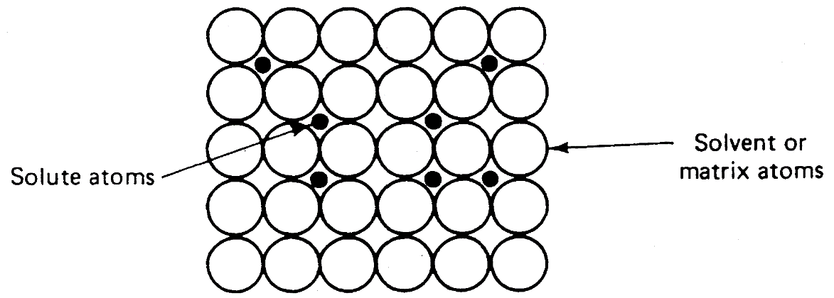
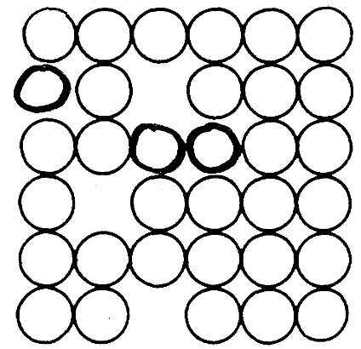
Point Defects
Substitutional
Interstitial
Vacancy

Slide 19
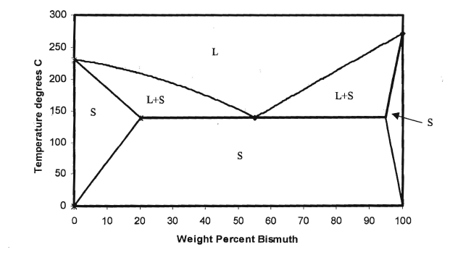
Bismuth/Tin –

Slide 20



Slide 21



Slide 22




Slide 23



Slide 24

42

Slide 25


Slide 27
Lead/Tin

