Slide 1
Magnetic fields

Slide 2
MAGNETS, NON MAGNETS, AND MAGNETIC (REVIEW)
What makes a material a permanent magnet?
What makes a material magnetic?
On your worksheet draw at least 5 arrows in each material to demonstrate what happens in a magnetic material when it is brought near a magnet.

Slide 3
So the magnetic field causes the change in the domains of the magnetic material (like a paperclip)
Is it possible for us to “See” the magnetic field?

Slide 4
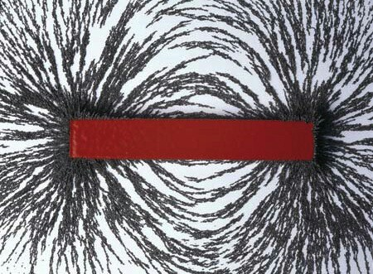
iron filings near a magnet
https://www.youtube.com/watch?v=j8XNHlV6Qxg

Slide 5
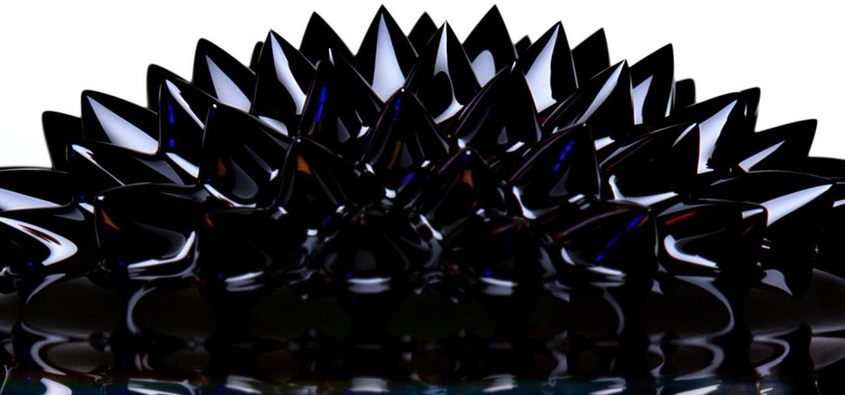
Ferrofluids and magnetic fields
https://www.youtube.com/watch?v=L8cCvAITGWM

Slide 6
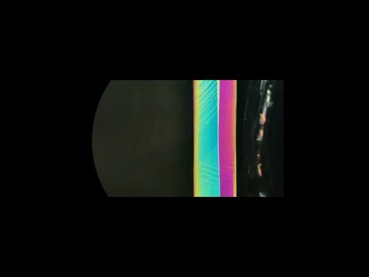
Looking to the future
MSMs
Magnetic Shape Memory alloys (MSMs)
are metals that change their size and shape
when exposed to a magnetic feild

Slide 7
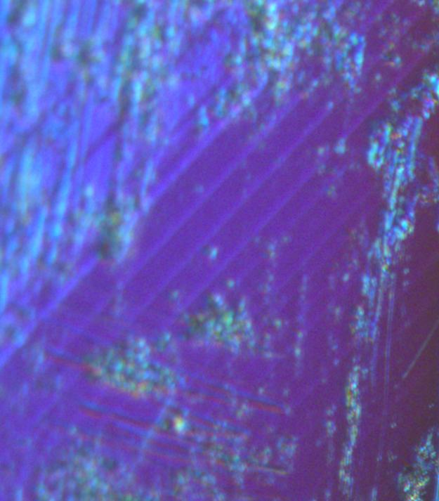
Uses of MSMs
“micropumps” for delivering small amounts of medicine
What do you think we could do if we could shape metal
when we wanted?

